Slide 1

www/jspiders.com/placements
BASAVANAGUDI
Welcome to
JSPIDERS BASAVANAGUDI

Slide 2

Duration : 2hrs
Trainer : Mr.Madhu Sundar
Subject : CORE JAVA
Software Development Introduction
BASAVANAGUDI

Slide 3
Software
Software : A software is a group programs which is developed to solve a business problem.
Program : It is a set of instructions which are developed to perform a particular task.
BASAVANAGUDI

Slide 4
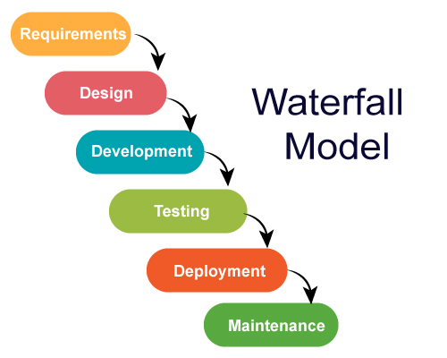
BA(Business Analyst)
Collects the requirements
From the client
BA is expert in the domain
For which the company is planning to develop the software
SDLC
Developers starts coding the application
Based on the LLD given by the Architect
Technical Architect is will design the application based on his experience.
Design is of 2 types
Low Level Design
High Level Design
Test Engineers test the application Manually or using Automation tools against the requirements of the application.
If the application is not working according to requirements the its called a BUG. If bugs are found it should be fixed by developer and s/w will be tested again
A team of Filed Engineers will install the application in Clients Machine or in Servers to start using the application for Real Time Business
A team of Production Engineers will be
24/7 available to keep the S/w running.
Any bugs are found by the Client should
Be fixed by developers.

Slide 5
Types of Software
Standalone Apps
Client/Server Apps
Web Application
Standalone Apps
Any application that runs without any network is called as standalone apps.
Ex : Notepad, Calculator , Calendar etc..
BASAVANAGUDI

Slide 6
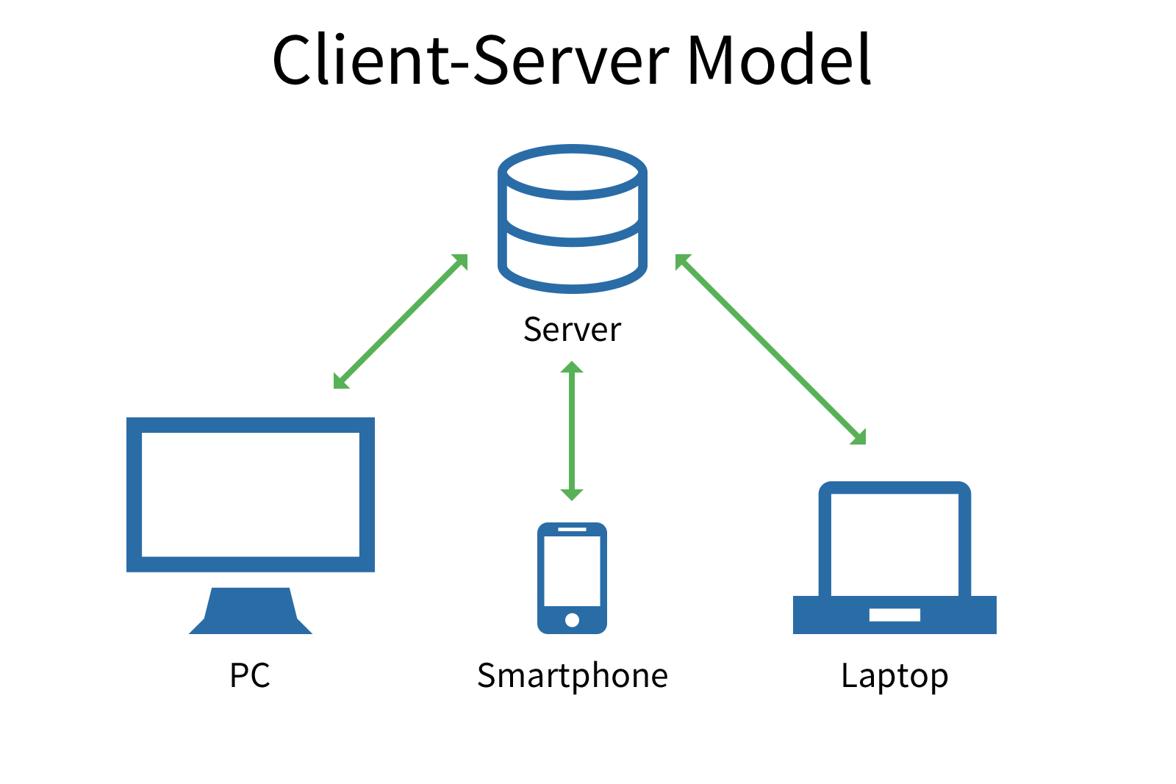
Client/Server Apps
Any application that requires network for its execution is called as client/server apps.
The software developed to access the services of the Server is called as Client.
Client is always installed in user machine( Computer/Mobile Devices)
The software and hardware that receives the request from the client and process it to provide the service is called as Server
Ex : whatsapp, messenger , skype
BASAVANAGUDI

Slide 7
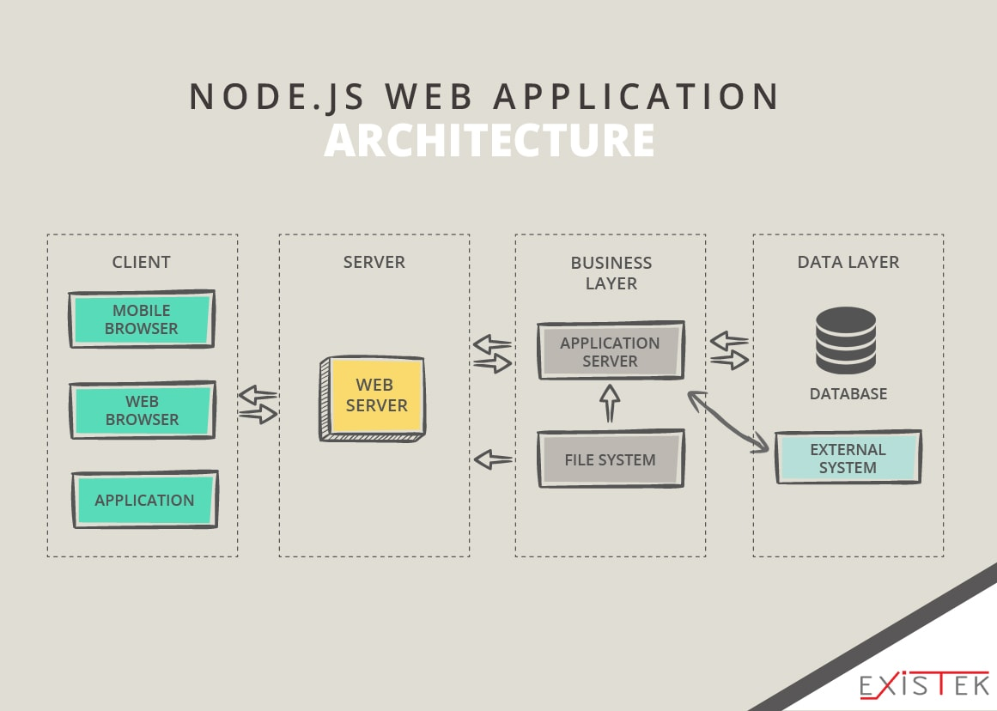
Web-Applications
Any application that requires web browser for its execution is called as web application.
Web App will have 3 layers.
Presentation Layer
Application Layer
Data Layer
BASAVANAGUDI

Slide 8
Web-Applications
Presentation layer consists of web pages which is the front end of web application and it is developed by using HTML,CSS,JS etc..
Application layer consists business logics which process the inputs from front end and provides necessary service by executing the corresponding programs in APP server.
Data layer consists all the business data that is required to run the application such as User details, Account information, Settings data etc.
BASAVANAGUDI

Slide 9
Duration : 2hrs
Trainer : Mr.Madhu Sundar
Subject : CORE JAVA
Program and Programming Language Fundamentals
BASAVANAGUDI

Slide 10
Program
Program : It is a set of instructions which are developed to perform a particular task.
Program Language : It is a language to communicate with a computer from a programmer.
Father of programming lang: Dennis Ritchie(c and unix).
Mother of programming lang: Ada Lovelace(mid-1800).
Father of java programming lang: James Gosling
BASAVANAGUDI

Slide 11

Converts high level language to Assembly level language
low level language or binary language
ON/OFF
Take a
Take b
Store 10,a
Store 10,b
Take c
Add a,b
Store c
Print c
a=10
b=10
c=a+b
Print c
Complier
0 1 0 1 0 1 0 1
Assembler
High level language
C, C++,java ,python ,JS, SQl
Assembly level language
8086 8085
Converts assembly level language to low level language or binary language
BASAVANAGUDI

Slide 12


Birth of Java
Assembly level language created by the assembler can be executed only the same computer which has same OS and CPU in which program was develped and this makes all S/W developed using this language dependent on the platform.
SunMicroSystems a software development company had the vision of developing a programming language which was completely platform independent.
In 1990 a team of Researchers led by James Gosling starts research to develop a platform independent programming language.
In the year 1995 official version of JAVA was first released to the market

Slide 13
JDK(Java Development Kit)
-------
----
-----
-----
---
JVM
Java Virtual Machine
Javac
Java compiler
Bytecode
* Check the syntax of the
program.
if syntax mistake
throw Compile Time Error
else
create convert java code to
bytecode and save it .class
file.
Read a line of code.
Understand a line of code
Execute a line of code
if code is not understandable
throw Run Time Error
or Exception
else
execute the code
Demo.java
Demo.class
Create java program using
Code Editors : Sublime text, Notepad++, Editplus etc..
IDE: NetBeans, Eclipse , IntelliJ , Jcreator
BASAVANAGUDI

Slide 14
Java Development Kit (JDK) is a software development environment used for developing Java applications and applets. It includes the Java Runtime Environment (JRE), an interpreter/loader (Java), a compiler (javac), an archiver (jar).
Applets are small Internet-based program written in Java, a programming language for the Web and can be downloaded by any computer. The applet is also capable of running in HTML.
JAR stands for Java ARchive. It's a file format and is used for aggregating many files into one. ... the only format that handles audio and image files as well as class files.

Slide 15
Duration : 2hrs
Trainer : Mr.Madhu Sundar
Subject : CORE JAVA
Installation of JDK and Sublime Text
BASAVANAGUDI

Slide 16
Learning objectives
How to set-up JDK for java development.
Learn how to compile and execute java programs
Understanding structure of java program.
BASAVANAGUDI

Slide 17
Trainer : Mr.Madhu Sundar
Subject : CORE JAVA
Chapter 1
Keywords, Identifiers and Variables
BASAVANAGUDI

Slide 18
Keywords
Keywords are those reserved words which will have a pre-defined
meaning defined in the programming language.
Keyword should be written only in lowercase.
https://docs.oracle.com/javase/tutorial/java/nutsandbolts/_keywords.html
BASAVANAGUDI

Slide 19
Identifiers
It is a name which is used to identify package, interface, Class, Methods and Variables.
Identifiers are the names given for an entity in a program.
RULES OF IDENTIFIERS.
Identifiers can be alpha-numeric.
Identifiers should not start with numeric .
$ and _ are the only 2 special characters that can be used with Identifiers.
Identifiers can start with $ or _
Single _ is an invalid identifier in java.
Keywords can not be used as identifiers.
BASAVANAGUDI

Slide 20
Variables
A named memory location which is used to store values for the program is called as variable.
To use a variable we have to follow 3 steps
Declaration
Initialization
Utilization
BASAVANAGUDI

Slide 21
Variables
Declaration is a statement which written to specify the type of data to be stored in the given variable.
syntax : datatype varName;
DataType | Capacity | Default value
byte | 8-bits or 1-byte | 0
short | 16-bits or 2-bytes | 0
int | 32-bits or 4-bytes | 0
long | 64-bits or 8-bytes | 0l
float | 32-bits or 4-bytes | 0.0f
double | 64-bits or 8-bytes | 0.0
char | 16-bits or 2-bytes | Space
boolean | 8-bits or 1-byte | false
BASAVANAGUDI

Slide 22
Initialization
Initialization : It is a statement which is written to store the data within a variable using assignment operator(=).
syntax : varName = value;
Utilization
Utilization : It is one or group of statements which is written to store the value in the variable to perform the operation.
syntax : datatype varName = value;
BASAVANAGUDI

Slide 23
Duration : 2hrs
Trainer : Mr.Madhu Sundar
Subject : CORE JAVA
Chapter 2
Operators
BASAVANAGUDI

Slide 24
Operators
Operator performs operations on operands and produce results.
Types of operators
Arithmetic Operators
+ - * / %
Increment and Decrement Operators
++ --
Comparison Operators or Relational Operators
< > == != <= >=
Logical Operators && || ^
Bitwise Operators & | ^
BASAVANAGUDI

Slide 25
Priority | Operator | Operation
1 | () [] -> . :: | Function call, scope, array/member access
2 | ! ~ - + * & sizeof type cast ++ -- | (most) unary operators, sizeof and type casts (right to left)
3 | * / % MOD | Multiplication, division, modulo
4 | + - | Addition and subtraction
5 | << >> | Bitwise shift left and right
6 | < <= > >= | Comparisons: less-than and greater-than
7 | == != | Comparisons: equal and not equal
8 | & | Bitwise AND
9 | ^ | Bitwise exclusive OR (XOR)
10 | | | Bitwise inclusive (normal) OR
11 | && | Logical AND
12 | || | Logical OR
13 | ? : | Conditional expression (ternary)
14 | = += -= *= /= %= &= |= ^= <<= >>= | Assignment operators (right to left)
15 | , | Comma operator
BASAVANAGUDI

Slide 26
Increment Operator
Increment operator will increase the value of a variable by one unit;
Pre-Increment Post-Increment
*increment *substitute
*substitute *operation
*operation *increment
Both Pre-Increment and Post-Increment Operators will show same results if they are used without any expressions or java statements.
Whenever the increment Operator is used with a character variable the unicode value of the character will be increased and its corresponding character will be stored in the given variable.
Boolean variables cant be used with increment operator.
Values cant be directly used with increment operator
BASAVANAGUDI

Slide 27
Comparison Operators
Comparison operators will compare given 2 values and returns a Boolean result
Logical Operators
Logical operators are used to combine multiple Boolean conditions as ONE
single condition.
Logical operators will always return a Boolean result
Different types of logical operators are
Logical AND (&&)
Logical OR(||)
Logical XOR(^)
BASAVANAGUDI

Slide 28
Logical AND &&
Logical AND && operators will return TRUE if and only if the result of both the
Boolean condition’s result is TRUE and in all other cases it returns FALSE
TRUTH table for LOGICAL AND (&&)
CONDITION 1 | CONDITION 2 | RESULT
TRUE | TRUE | TRUE
TRUE | FALSE | FALSE
FALSE | TRUE | FALSE
FALSE | FALSE | FALSE
BASAVANAGUDI

Slide 29
Logical OR ||
Logical OR || operator will return FALSE if and only if the result of both the
Boolean condition’s result is FALSE and in all other cases it returns TRUE
TRUTH table for LOGICAL OR (||)
CONDITION 1 | CONDITION 2 | RESULT
TRUE | TRUE | TRUE
TRUE | FALSE | TRUE
FALSE | TRUE | TRUE
FALSE | FALSE | FALSE
BASAVANAGUDI

Slide 30
Logical XOR ^
Logical XOR ^ operator will return FALSE if and only if the result of both the
Boolean condition’s result is FALSE or TRUE and in all other cases it returns TRUE
TRUTH table for Logical XOR ^
CONDITION 1 | CONDITION 2 | RESULT
TRUE | TRUE | FALSE
TRUE | FALSE | TRUE
FALSE | TRUE | TRUE
FALSE | FALSE | FALSE
BASAVANAGUDI

Slide 31
Bitwise Operator
Bitwise operator will perform bitwise operations on every bit of given value and
produce results as 0 or 1
25
2|12-1
2|6-0
2|3-0
2|1-1
Result : 11001
100
2|50-0
2|25-0
2|12-1
2|6-0
2|3-0
2|1-1
Result : 1100100
0011001
1100100(&)
------------------
0000000
0*2^6+ 0*2^5+ 0*2^4+ 0*2^3+ 0*2^2+ 0*2^1+
0*2^0 =
RESULT : 0
0011001
1100100(|)
------------------
1111101
0011001
1100100(^)
------------------
1111101
BASAVANAGUDI

Slide 32
Concatenation Operator
concatenation oprt(+) : Is used to join a String value with any other data.
Between a string and any other type if you use + oprt it will join the string and given
value creating a new String.
Ex : "hello"+"world“
“hello"+10
BASAVANAGUDI

Slide 33
Trainer : Mr.Madhu Sundar
Subject : CORE JAVA
Chapter 3
Methods/ Functions
BASAVANAGUDI

Slide 34
methods
It is used to execute a sequence of statement.
Methods are used to eliminate duplicate lines of code in the program.
Methods are named blocks of codes which will perform a specific task.
Syntax : access access return name(parameter list)
specifier modifiers type
{
stmt..
stmt..
return;
}
Access modifier : static.
Access specifier : public, protected, pkg-level, private.
Return type : depends on the data type of which type of value we are returning.
BASAVANAGUDI

Slide 35
methods
return statement is used to transfer the control and the values from called
method to calling method.
A method which is calling another method is known as calling method.
A method which is called by another method is known as called method.
If methods do not return any value then its return type should be declared
as void.
BASAVANAGUDI

Slide 36
Trainer : Mr.Madhu Sundar
Subject : CORE JAVA
Chapter 3
FLOW CONTROL STATEMENTS
BASAVANAGUDI

Slide 37
Flow control statements
Flow control statements are used to control the execution flow of the program at
the runtime.
Flow control statements are of 2 types
Decision Making Statements
Looping Statements
BASAVANAGUDI

Slide 38
Decision Making Statements
Decision Making Statements are used to execute one or group of statements based on a Boolean condition.
Boolean cond / Boolean exp : a Comparison statement written using Comparison
opts and logical opts is called Boolean exp/cond.
Types of Decision making statements are
IF
If-else
if-else-if
Switch-case

Slide 39
if - statement
it is a type of decision making if the given conditions satisfies then the statement which is written within the if body will executed.
Syntax : if(Boolean cond)
{
stmt..
stmt.
}

Slide 40
if - else statement
it is a type of decision making if the given conditions satisfies then the statement which is written within the if body will executed or else Else part will be executed.
Syntax : if(Boolean cond)
{
stmt..
stmt.
}
else
{
stmt
stmt
}

Slide 41
if – else - if statement
It is a type of decision making statements which is used to whenever there are multiple Boolean conditions to be evaluated to execute different set of statements.
Syntax : if(Boolean cond1)
{
stmt..
stmt.
}
else if(Boolean cond2)
{
stmt
stmt
}
else
{
stmt
stmt
}

Slide 42
switch case - statement
It is a type of decision making statements which is used whenever there are only equals conditions to be evaluated to execute different set of statements.
Syntax : switch(choice)
{
case choice 1 : stmts
break;
case choice 2 : stmts
break
default : stmts
}

Slide 43
Looping Statements
Looping Statements are used to execute one or multiple Statements repeatedly.
In java there are 4 looping statements
For loop
While loop
do-while loop
for-each loop
BASAVANAGUDI

Slide 44
Looping Statements
class Email
{
sendmail(int num)
{
loop(num) num = no. of To email ids
{
—-
——
}
}
}
To : xyz@gmail.com
pqr@gmail.com
Subject : ————-
———————————
msg
Send
BASAVANAGUDI

Slide 45
For loop
for-loop is used whenever logical start and logical end is very well defined.
syntax :
start check did you reach the end
for(intialization; stop_condition; counter)
{
stmts..
stmts...
}
BASAVANAGUDI

Slide 46
Trainer : Mr.Madhu Sundar
Subject : CORE JAVA
Chapter 3
ARRAYS
BASAVANAGUDI

Slide 47
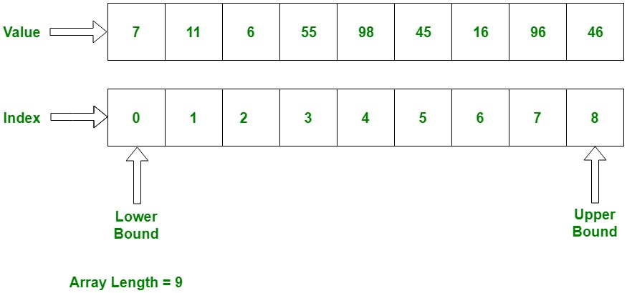
Arrays
Array is a group of same type of data which has a fixed length and index to identify every bucket uniquely.
0 1 2 3 4 5 6 7 8
Upper Bound
Lower Bound
Array Length = 9
BASAVANAGUDI

Slide 48
Arrays
Array Decleration
syntax : datatype[] arrayVarName;
ex : int[] arr;
syntax : datatype arrayVarName[];
ex : int arr[];
[] -> subscript
Array Creation
syntax : arrayVarName = new datatype[size];
ex : arr = new int[10];
BASAVANAGUDI

Slide 49
Arrays
Array Decleration and Creation
syntax : datatype[] arrayVarName = new datatype[size];
ex : int[] arr = new int[10];
Once the array is created all the buckets will be filled with default values depending on the data type of the array.
length is an in-built variable which contains the count of no. of buckets in the given array.
Array Decleration and Creation
syntax : datatype[] arrayVarName = {v1,v2,v3...};
ex : int[] arr = {20,40,12};
BASAVANAGUDI

Slide 50
Arrays
first index -> 0 (lower bound)
last index -> arr.length - 1 = 9-1 = 8 (upper bound)
mid index -> (arr.length-1)/2 = (9-1)/2 = 4(middle bound)
BASAVANAGUDI

Slide 51
Trainer : Mr.Madhu Sundar
Subject : CORE JAVA
Chapter 3
Strings
BASAVANAGUDI

Slide 52
Strings
String value is a group of characters which is written in the double quotes.
A String in Java is actually an object, which contain methods that can perform certain operations on strings.
We can access the characters or perform any operations on the string only by
using the methods of String.
Internally String value is stored as a character Array by the JVM.
‘h’ | ‘e’ | ‘l’ | ‘l’ | ‘o’
0 | 1 | 2 | 3 | 4
String str = “hello”
BASAVANAGUDI

Slide 53
Methods of String
length() : It returns the count of number of characters present in the given String.
charAt(index) : It returns the character at the given index from the given String.
indexOf(char) : It returns the index of the given character from the given String. It returns -ve value if the character do not exist.
indexOf(char,startIndex) : It returns the index of the given character
from the given String by starting the search from the given startIndex.
equals(string) : It compares characters of given two strings and returns
true if they are exactly same else it returns false.
BASAVANAGUDI

Slide 54
Methods of String
equalsIgnoreCase(string) : It compares characters of given two strings by
igiorning the case and returns true if they are exactly same else it returns false.
substring(start, end-1) : It creates a String from the given start index and given end-1 index no. of characters and returns the String.
NOTE
length and length()
length -> variable used in array
length() -> method of String
BASAVANAGUDI

Slide 55
Duration : 2hrs
Trainer : Mr.Madhu sundar
Subject : CORE JAVA
Section :OOPS
Object Oriented Programming System
BASAVANAGUDI

Slide 56
Section 2 Object Oriented Programming Syllabus
- Classes and Objects
- Object creation
- Reference variable
- Global and local variables
- Constructors
- Composition
- Inheritance *****
- Method Overloading
- Method Overriding
- Abstract classes
- Interfaces
- Typecasting
- Polymorphism
Abstraction
Java packages
Access Specifiers
Encapsulation

Slide 57
Duration : 2hrs
Trainer : Mr.Madhu sundar
Subject : CORE JAVA
Section :OOPS
CLASSES
and
Objects
BASAVANAGUDI

Slide 58
Class
Class is blueprint of an object.
A class will have 2 types of members
Data members
Function members
Data members are those variables which are declared within the body of the class.
Function members are those methods/functions which are declared within the body of the class.
Members of the class are of 2 types
static
non-static
BASAVANAGUDI

Slide 59
object
An object is an instance of a class. it is mainly used to allocate memory of a class member & member Function
These are also referred to as Non-primitive .
applications
Objects are can be created to call a non-static function.

Slide 60
Static Members
Any data member or function member of the class declared by using static keyword is called as STATIC MEMBER.
Present in different class
Static member present in different class can be accessed by using class name
with member name.
Ex : ClassName.memberName
Present in same class
Static member present in same class can be accessed just by using mebername.
BASAVANAGUDI

Slide 61
Non-Static Members
Any data member or function member of the class declared by without using static keyword is called as NON-STATIC MEMBER.
Present in different class
Non-Static member present in a different class can be accessed within any method of a different class only by creating the object of the class.
BASAVANAGUDI

Slide 62
Object creation
Object of a class can be created by using following syntax :
new ClassName();
Creates a new object
in the memory of
the given class
and returns its
address
Constructor Call or class name
Copy all the non-static
members of the class to
the new object created
BASAVANAGUDI

Slide 63
Present in same class
Non-Static member present in a class can be accessed within a static method only by creating the object of the class.
Non-Static member present in a class can be accessed within a non-static method directly by using membername.

Slide 64
ACCESSING MEMBERS
ACCESS MODIFIER LOCATION | STATIC | NON-STATIC
SAME CLASS | Just by using the member name | Static method : only by creating the object of the class. Non-Static method : Just by using the member name.
DIFFERENT CLASS | Using classname with the member name. ClassName.membername | only by creating the object of the class
BASAVANAGUDI

Slide 65
Static Members
Static members will have only one copy in the memory.
If the value of a data member in a class is not changing from object other object
then those data members should be declared as static.
If a function member / method in a class is using only static members of the class
then those function member / method should be declared as static.
BASAVANAGUDI

Slide 66
NON-STATIC MEMBERS
Non-Static members will have multiple copy in the memory.
If the value of a data member in a class is changing from object other object
then those data members should be declared as non-static.
If a function member / method in a class is using at least one non-static members of the class then those function member / method should be declared as non-static.
BASAVANAGUDI

Slide 67
Reference Variables
It is a type of variable which is used to store address of an object.
Within a reference variables we can’t store primitive values.
Within a primitive variables we can’t store address of an object.
Within one reference variables we can store ONLY ONE OBJECT ADDRESS.
Multiple reference variables can point to same object.

Slide 68
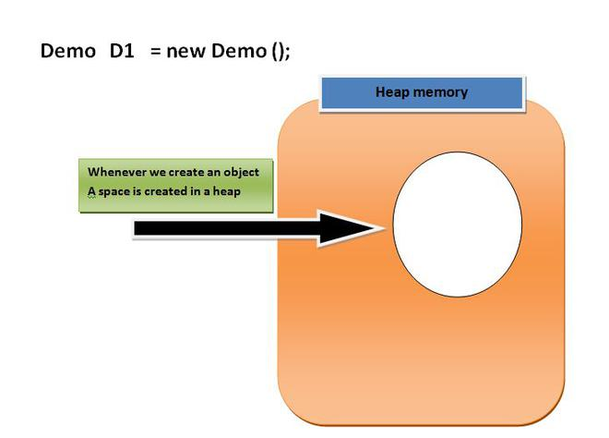
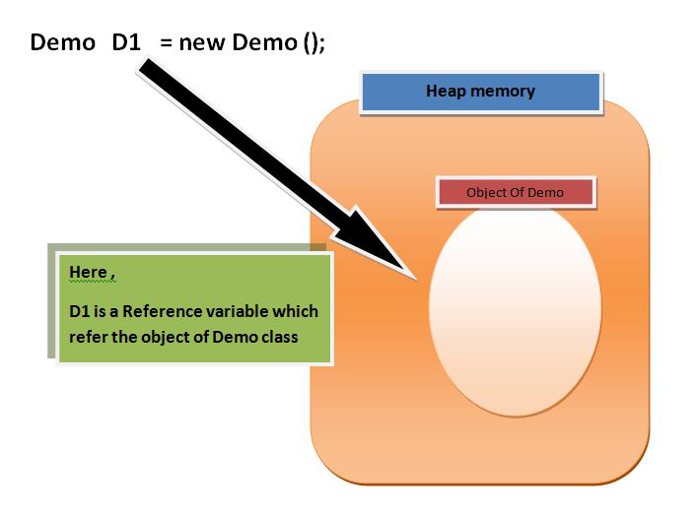
Class, interface, arrays, enumeration are reference types in java.
When we create an object (instance) of class then space is reserved in heap memory.
Demo D1 = new Demo();
Then how to access heap memory ?
The heap memory is the area of memory used to store objects.
Just by creating a reference variable.it will point object in heap memory.

Slide 69
Trainer : Mr.Madhu sundar
Subject : CORE JAVA
Chapter 2
Global variables and Local variables
BASAVANAGUDI

Slide 70
Global variables
Any variable which is declared within the body of the class is called Global variable.
Global variables can be accessed by any method present in same class.
Global variables will be initialized by the compiler with the default values if the programmer do not initialize them.
Global variables are nothing but DATA MEMEBERS of the class.
Local variables
Any variable which is declared with the method declaration and within the method definition is called as local variable.
Local variables can be accessed only by the method in which it is declared.
Local variables should be initialized by the programmer with the values explicitly.
BASAVANAGUDI

Slide 71
Trainer : Mr.Madhu sundar
Subject : CORE JAVA
Chapter 3
Constructors
BASAVANAGUDI

Slide 72
Constructors
Constructors are special type of methods which have same name as the class name..
Constructors are executed whenever the object of that corresponding class is created.
Every class must and should have Constructor.
If the programmer do not write any constructor, then compiler will write default constructor implicitly.
If the programmer writes constructor it can be of two type
1. Zero argument constructor
2. Parameterized constructor
Constructors cannot be declared as static or final.
If you specify return type for the constructor, then it will be considered as a normal method.
App.
Constructors are used to Intialize the data members of the class.
BASAVANAGUDI

Slide 73
Constructors cannot be declared as static or final why?
Static: because as we know that constructor will be executed whenever the object is created object is created for non static not for static so.
Final: because final method cannot be overridden by any of the sub class or it cannot be inherited.
Why constructor cannot be inherited: because subclass has a different name.
If we inherit constructor we cannot achieve encapsulation.
class book{
public book(){
System.out.println("done");
}
}
class pen extends book{
public book(){
System.out.println("finish");
}
}
class notes {
public static void main(String[] args) {
book b1=new book();
pen p=new pen();
}
}

Slide 74
This keyword
this keyword is used to differentiate between local variables and Global variables if both the variable name is same.
BASAVANAGUDI

Slide 75
f
Trainer : Mr.Madhu sundar
Subject : CORE JAVA
Chapter 5
Inheritance
BASAVANAGUDI

Slide 76
Inheritance
One class acquiring the properties of another class is called is inheritance.
The class from where properties are inherited is called as superclass or base class or parent class.
The class which is inheriting properties is called as sub class or derived class or child class.
In java inheritance is achieved by using extends keyword.
Using superclass object we can access ONLY properties of superclass
Using subclass object we can access properties of both subclass and superclass
final classes CANNOT be inherited.
final data members and function members of the class can be inherited.
constructors of the class CANNOT be inherited.
private data members and function members of the class CANNOT be inherited.
Using subclass object we can access both static and non-static properties of both subclass and superclass
BASAVANAGUDI

Slide 77
final classes CANNOT be inherited why ?
the main purpose of class being declared as final is because to prevent the class from being subclassed
Why constructor cannot be inherited ?
because subclass has a different name.
If we inherit constructor we cannot achieve encapsulation.
class book{
public book(){
System.out.println("done");
}
}
class pen extends book{
public book(){
System.out.println("finish");
}
}
class notes {
public static void main(String[] args) {
book b1=new book();
pen p=new pen();
}
}

Slide 78
Inheritance
Different types of inheritance are
1. Single inheritance
2. Multilevel inheritance
3. Multiple inheritance
4. Hierarchical inheritance
5. Hybrid inheritance
BASAVANAGUDI

Slide 79
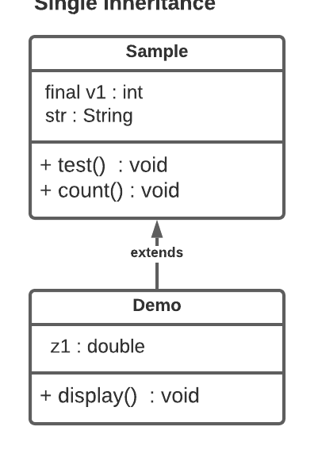
Single inheritance
one Subclass inheriting from one Single Superclass is called as Single Inheritance.
BASAVANAGUDI

Slide 80
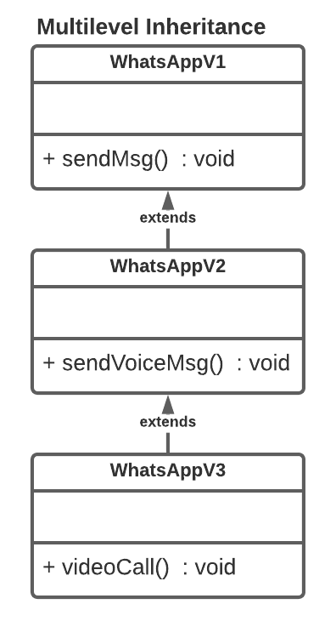
Multilevel Inheritance
Subclass inheriting the properties of superclass and that superclass inheriting the properties from another superclass is called as Multilevel inheritance.
BASAVANAGUDI

Slide 81
Multiple inheritance
Subclass inheriting the properties from 2 or more superclass is called as Multiple inheritance.
Java don't support Multiple inheritance.
BASAVANAGUDI

Slide 82
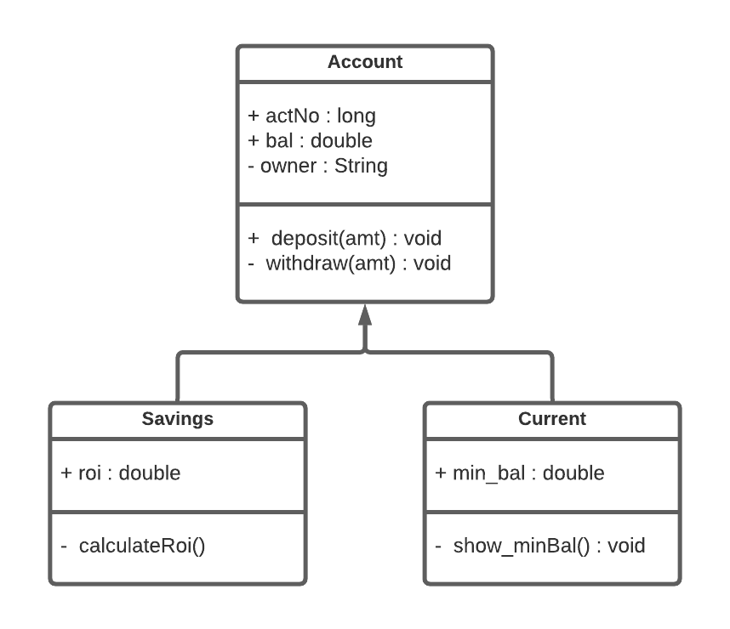
Hierarchical inheritance
One superclass inherited/extended by two or more subclasses is called as Hierarchical inheritance.
BASAVANAGUDI

Slide 83
Generalization
Declaring same methods and variables in all sub class to one superclass.
BASAVANAGUDI

Slide 84
Specialization
Declaring specific methods and variables in sub class.
BASAVANAGUDI

Slide 85
Hybrid Inheritance
It is the combination of Different types inheritance.
BASAVANAGUDI

Slide 86
super statement
super(); (super statement)
super(); creates the object of superclass whenever object of subclass is created to inherit the properties.
super(); can be written explicitly by the programmer or implicitly by the compiler at the compile time.
If the superclass contains only parameterized constructors then the programmer should write super(); explicitly and pass the required arguments.
super(); must be written ONLY within the constructor body.
should be always written at the first line of constructor body.
Multiple super(); within the same constructor body is NOT allowed. because writing Multiple super(); may lead to creation of multiple superclass objects which is not required.
BASAVANAGUDI

Slide 87
Inheritance
Object class is the super Most class in java.
Each and every class directly or indirectly inherits from object class .
Why java do not support Multiple Inheritance?**OR Explain Diamond problem in java? (this is the problem raise in multiple inheritance )
because It may creates an ambiguity/confusion for the complier from which superclass the sub class should access the properties.
If both super classes have methods with same name and same arguments, then it creates an ambiguity for the complier to choose which method should be called for the execution when it called using subclass object.
Constructor chaining :
It is the process of subclass constructor calling its superclass constructor and superclass constructor calling object class constructor.
BASAVANAGUDI

Slide 88
f
Trainer : Mr.Madhu sundar
Subject : CORE JAVA
Chapter 6
Method Overloading
BASAVANAGUDI

Slide 89
Method Overloading
Developing multiple methods within the same class with the same name but difference in
1. Number of arguments
2. Data type of arguments
3. Order of arguments
is called as Method Overloading.
Ex: println() is the best example for Method Overloading.
Advantage: It is easy to remember method which may perform similar operation with different arguments.
Disadvantage: If proper documentation are not maintained for every overloaded method it will be difficult for the new developer to understand behavior of every method.
BASAVANAGUDI

Slide 90
f
Trainer : Mr.Madhu sundar
Subject : CORE JAVA
Chapter 6
Constructor Overloading
BASAVANAGUDI

Slide 91
Constructor Overloading
Developing multiple constructors within the same class with the same name but difference in
1. No. of arguments or
2. data type of arguments or
3. order of arguments
is constructor overloading
BASAVANAGUDI

Slide 92
f
Trainer : Mr.Madhu sundar
Subject : CORE JAVA
Chapter 7
Method Overriding
BASAVANAGUDI

Slide 93
Method Overriding
Subclass inheriting method of superclass without changing method declaration just by changing the method definition is called as method Overriding.
Inheritance is mandatory for method Overriding.
@ -> annotation
@Override (Override annotation) it compares the given method declaration of subclass with every other method declaration present in superclass and throws an error if there is no matching declaration found.
Final, Private and Static methods cannot be Overridden.
If Subclass and Superclass contains STATIC methods with same name and same arguments then it is called as Method Hiding.
super keyword
super keyword is special in-built reference variable which is crated by JVM and it will point to immediate Parent class object.
super keyword is used within the subclass methods in order to access properties of its immediate superclass.
BASAVANAGUDI

Slide 94
f
Trainer : Mr.Madhu sundar
Subject : CORE JAVA
Chapter 8
Abstract class and Abstract methods
BASAVANAGUDI

Slide 95
Abstract
incomplete
A method which has only method declaration and no method definition is called as Abstract method.
Abstract method must be declared by using abstract keyword.
If a class contains at least one abstract method, then the class must be declared as abstract class.
It is impossible to create object of an Abstract class.
We can create reference variables of abstract class type.
A method which has both method declaration and method definition is called as concrete method.
If a class contains only concrete methods, then the class is called as concrete class.
If a class inherits from an abstract class then the subclass must override all the abstract methods present in super class else the class must be declared as abstract(incomplete).
BASAVANAGUDI

Slide 96
Abstract
abstract methods cannot be declared as
final
static
private
within an abstract class we can write
1. only abstract methods or
2. only concrete methods or
3. both abstract and concrete methods
BASAVANAGUDI

Slide 97
Abstract
Application of Abstract class:
By using abstract classes we can ensure there are no missing method implementations the subclass.
Abstract acts a blueprint to create concrete class.
final class cannot be inherited
- final methods can be inherited but cannot be overridden
- final variables can be inherited but cannot be re-intialized
BASAVANAGUDI

Slide 98
f
Trainer : Mr.Madhu sundar
Subject : CORE JAVA
Chapter: 9
Interface
BASAVANAGUDI

Slide 99
Interface
Interface is a type where methods are by default abstract and variables are by default static and final.
It is impossible to create object of an interface.
We can create reference variables of interface type.
The class can inherit the properties of an Interface only by using Implements keyword.
The interface from where properties are inherited is called as Super Interface
The class which is implements the interface is called as Implementation Class
If a class implements an interface then the implementation class must override all the abstract methods present in super Interface else the class must be declared as abstract class.
An interface cannot implements another interface.
An interface should only extends another interface.
BASAVANAGUDI

Slide 100
Interface
A class can implements any number of interfaces.
A class can extends and implements at the same time.
A class can extends ONLY one Superclass but it can implements any number of interfaces at the same time.
Application
It is used to achieve total abstraction.
Since java does not support multiple inheritance in case of class, but by using interface it can achieve multiple inheritance .
From JDK 8 interfaces now on supports concrete methods.
BASAVANAGUDI

Slide 101
Interface
if you want a concrete method within the interface which you want to be overridden in implementation classes then method shall be declared as default method.
static methods of interface can be accessed by using interface name with dot(.) operator.
default methods of interface can be accessed by using Object of its implementation class ONLY.
If two interfaces contains static methods with the same name and same arguments then , we differentiate them with help of Interface Name.
If two interfaces contains default methods with the same name and same arguments then , it should be overridden in the implementation class.
BASAVANAGUDI

Slide 102
f
Trainer : Mr.Madhu sundar
Subject : CORE JAVA
Chapter: 10
TypeCasting
BASAVANAGUDI

Slide 103
TypeCasting
Converting one Type to another Type is called is TypeCasting.
TypeCasting is of 2 types
Primitive Casting
Derived Casting
Converting one Primitive data type value to another Primitive data type value is called as Primitive Casting.
Primitive Casting is of 2 types
Widening
Narrowing
Widening : Converting lower data type value to Higher Data type value
Widening is done implicitly by the compiler.
Narrowing : Converting higher data type value to lower Data type value.
Narrowing should be done explicitly by the programmer by writting
casting statement.
Syntax : (datatype) val/var;
BASAVANAGUDI

Slide 104
TypeCasting
Even though int and float have same capacity the data is represented in a different format.
Compared to float and int , float is higher data type and int is lower data type.
Even though long and double have same capacity the data is represented in a different format.
Compared to double and long , double is higher data type and long is lower data type.
BASAVANAGUDI

Slide 105
TypeCasting
Converting one object reference type to another object reference type is called as Derived casting.
Derived casting is of 2 types
1. Upcasting
2. Downcasting
Converting subclass object reference to superclass object reference is called Upcasting
Upcasting is achieved by storing the address of subclass object into superclass reference variable
Any superclass reference variable pointing to subclass object is called as Upcasted reference.
Using an Upcasted reference we can access only properties of superclass in the subclass object and it is impossible to access subclass properties.
Converting Upcasted object reference back to subclass object reference is called Downcasting.
Using an Downcasted reference we can access properties of superclass and subclass.
BASAVANAGUDI

Slide 106
TypeCasting
NOTE : INHERITANCE IS MANDATORY FOR DERIVED CASTING
what is ClassCastException?
Whenever we try downcast an upcasted reference to a different class reference which do not contains the properties of given object, then jvm will throw ClassCastException.
instanceof operator compares given object reference with the given class returns true if it contains the given class properties else it returns false..
*** If you want to access Parent class properties which is common to all Sub-class then, there is no need of performing any downcasting.
BASAVANAGUDI

Slide 107
f
Trainer : Mr.Madhu sundar
Subject : CORE JAVA
Chapter: 11
Polymorphism
BASAVANAGUDI

Slide 108
Polymorphism
One entity showing different behaviors at different places is called Polymorphism
It is the ability of an object to take many forms.
Polymorphism is of two types
1. Compile time Polymorphism
2. Runtime Polymorphism
Compile Time Polymorphism
Binding the method declaration to method definition by the compiler at the compile time based on the arguments is called as compile time Polymorphism.
Since the binding is done before the execution it is called as early binding.
Once the binding is done it cannot be changed at the Runtime and hence it is also called as Static Binding.
Method Overloading is the best example for Compile time Polymorphism ,
because the decision of which the method is to be called is at CT.
BASAVANAGUDI

Slide 109
Run Time Polymorphism
Binding the method declaration to method definition by the JVM at the run time based on the objects is called as run time Polymorphism.
Since the binding is done during the execution it is called as late binding.
Once the binding is done it can be changed at the Runtime and hence it is also called as dynamic Binding.
Method Overriding is the best example for Run time Polymorphism.
because the methods get resolved at RT.
Golden java rule
***** Using an upcasted reference if you call an overriden method then you always get the implementation of subclass.
BASAVANAGUDI

Slide 110
Polymorphism program:
Public class Manipulation(){ //Super class
public void add(){
}
}
public class Addition extends Manipulation(){ // Sub class
public void add(){
}
public static void main(String args[]){
Manipulation addition = new Addition();//Manipulation is reference type and Addition is reference type
addition.add();
}
}
Using the Manipulation reference type we can call the Addition class “add()” method. This ability is known as Polymorphism. Polymorphism is applicable for overriding and not for overloading.
Reference datatypes : those which contains reference/address of dynamically created objects. These are not predefined like primitive data types these are non primitive datatypes.

Slide 111
f
Trainer : Mr.Madhu sundar
Subject : CORE JAVA
Chapter: 12
Abstraction
BASAVANAGUDI

Slide 112
Abstraction
Abstraction - Hiding
Abstract - incomplete
Hiding the implementation details of a class and exposing only the services or behaviours of an object is called Abstraction
Abstraction is achieved by creating 3 layers
- Object Implementation layer
- Object creation layer
- Object utilization layer
Generalize all the subclass methods and declare them as abstract methods in a common Super Class or Super Interface and create Object Implementation layer
Create Object creation layer by Creating a class that will create the objects of implementation class and upcast it to Super Class or Super Interface reference.
Within the Object utilization layer utilize upcasted reference returned by Object creation layer to call the Generalized methods.
BASAVANAGUDI

Slide 113
Abstraction
Applications
By using Abstraction we can achieve loose coupling where changes done in object implementation layer will not have any impact on object utilization layer.
BASAVANAGUDI

Slide 114
f
Trainer : Mr.Madhu sundar
Subject : CORE JAVA
Chapter: 13
Java Packages
BASAVANAGUDI

Slide 115
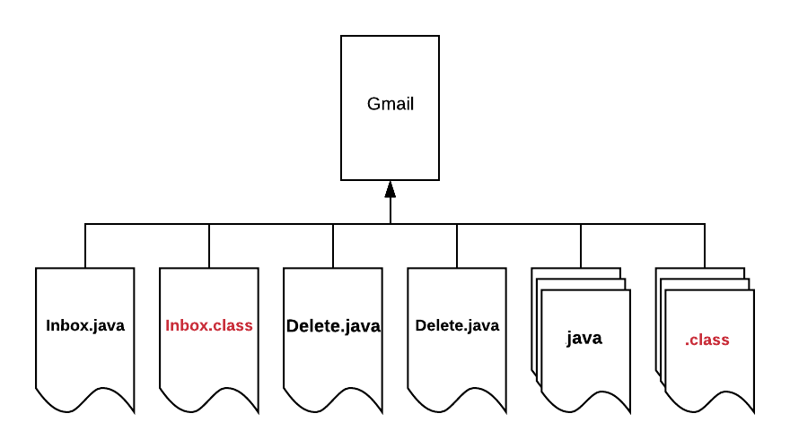
Packages
Managing Source code is difficult
Creates Naming collisions
Security for classes and its members is not guaranteed
BASAVANAGUDI

Slide 116
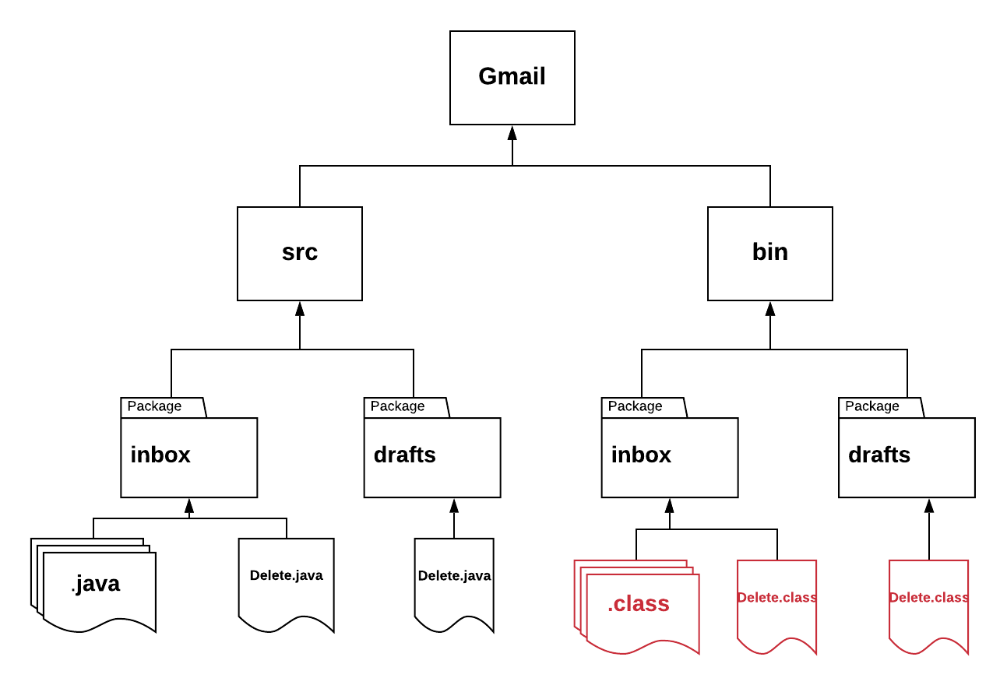
Packages
BASAVANAGUDI

Slide 117
Packages
a group of classes, sub packages and interfaces are wrapped in a single unit called packages
Package naming convention (rules)
package name is always written in all-lowercase.
package names are always written in reverse order of domain
convention 1
domain.appname.modulename
com.gmail.inbox
convention 2
domain.companyname.appname.modulename
com.google.gmail.inbox
BASAVANAGUDI

Slide 118
Packages
Data members and function members of a class present in different package can be accessed by two ways
Using fully qualified class names
Using import statement
A class name which is written with its package name is called as fully qualified class name.
an import statement will tells the compiler about the path of a class or entire package
BASAVANAGUDI

Slide 119
f
Trainer : Mr.Madhu sundar
Subject : CORE JAVA
Chapter: 14
Access Specifier
BASAVANAGUDI

Slide 120
Access Specifier
Access specifiers are used to provide security for the classes and its members by controlling the visibility.( about their visiblity )
Public
Protected
Security
visibility
Pkg-level
Visibility
security
Private
BASAVANAGUDI

Slide 121
Access Specifier
public :
if you declare any entity as public, then it can be accessed by the classes present in same or different package.
public entities will have highest visibility and lowest security.
protected :
If you declare any entity as protected, then it can be accessed by the classes present in same package.
protected entity can be accessed by other class present in different package through inheritance and creating the object of SUBCLASS ONLY.
pkg-level(default) :
if you declare any entity without using any access specifier keyword then it is considered as pkg-level member(default member).
if you declare any entity as pkg-level(default), then it can be STRCITLY accessed ONLY by the classes present in SAME package.
private :
if you declare any entity as private, then it can be accesses ONLY by the class within which they are declared.
private entities will have highest security and lowest visibility.
BASAVANAGUDI

Slide 122
f
Trainer : Mr.Madhu sundar
Subject : CORE JAVA
Chapter: 15
Encapsulation
BASAVANAGUDI

Slide 123
Encapsulation
Variables and methods are wrapped in a single unit called encapsulation.
Declaring data members as private and grant the access through getter and setter methods is called encapsulation
getter method returns the current value of the data member
setter method updates the value of the data member.
return type of getter method depends on the data type of the data member who's value will be returned
return type of setter method will be usually void because it doesn't return any value.
BASAVANAGUDI

Slide 124
Example:
We are declaring ‘a’ as an integer variable and it should not be negative.
public class Addition(){
int a=5;
}
If someone changes the exact variable as “a = -5” then it is bad.
In order to overcome the problem we need to follow the steps below:
We can make the variable private or protected.
Use public accessor methods such as set<property> and get<property>.
So that the above code can be modified as:
public class Addition(){
private int a = 5; //Here the variable is marked as private
}

Slide 125
Applications
Encapsulation is used to provide security for data members against the invalid values.
Code maintainability.

Slide 126
f
Trainer : Mr.Madhu sundar
Subject : CORE JAVA
Chapter: 15
SECTION 3
BASAVANAGUDI

Slide 127
f
Trainer : Mr.Madhu sundar
Subject : CORE JAVA
Chapter: 15
Java Libraries
BASAVANAGUDI

Slide 128
Java Libraries
Library : It is a set of classes and interfaces which is use to perform a specific task.
* java.lang
It contains all the classes which are essential to write simple
to develop complicated java applications.
* To use classes of java.lang package we need not write any import statement of fully qualified class names.
Object class
* Object class is super-most class in java
* Each and every class directly or indirectly inherits from object class
docs : https://docs.oracle.com/javase/8/docs/api/java/lang/Object.html
BASAVANAGUDI

Slide 129
Java Libraries
* methods of Object class
-hashCode()
-toString()
-equals()
-wait()
-wait(long)
-wait(long,int) } --> Threads
-notify()
-notifyAll()
-clone() --> Object cloning
-getClass()
-finalize() --> Garbage collection
BASAVANAGUDI

Slide 130
Java Libraries
hashCode()
* Returns a hash code value of the object.
* hash code value of an object is an unique integer value which is generated
by the jvm based on the address of the given object.
toString()
* Returns string representation of the Object
* String representation contains
→ Fully qualified class name
→ @ character
→ hexadecimal value of hashCode
equals(anotherobject)
* it compares the hashcode value of given 2 objects and returns true
if they are same else it returns false.
BASAVANAGUDI

Slide 131
Trainer : Mr.Madhu Sundar
Subject : CORE JAVA
Strings Class
BASAVANAGUDI

Slide 132
Strings
String value is a group of characters which is written in the double quotes.
We can access the characters or perform any operations on the string only by
using the methods of String.
Internally String value is stored as a character Array by the JVM.
String str = “hello”
‘h’ | ‘e’ | ‘l’ | ‘l’ | ‘o’
0 | 1 | 2 | 3 | 4
BASAVANAGUDI

Slide 133
Methods of String
length() : It returns the count of number of characters present in the given String.
charAt(index) : It returns the character at the given index from the given String.
indexOf(char) : It returns the index of the given character from the given String. It returns -ve value if the character do not exist.
indexOf(char,startIndex) : It returns the index of the given character
from the given String by starting the search from the given startIndex.
equals(string) : It compares characters of given two strings and returns
true if they are exactly same else it returns false.
BASAVANAGUDI

Slide 134
Methods of String
equalsIgnoreCase(string) : It compares characters of given two strings by
igiorning the case and returns true if they are exactly same else it returns false.
substring(start, no.of chras) : It creates a String from the given start index with given no. of characters and returns the String.
NOTE
length and length()
length -> variable used in array
length() -> method of String
BASAVANAGUDI

Slide 135
String Class
String value is group of chars written within double quotes
* In java String is a class which is used to store group of
chars the String object.
* String class is immediate sub-class of Object class
* String class implements Serializable, Comparable<String>, CharSequence interfaces
String class is final and it cannot be inherited.
hashCode() of Object class is overriden in String class.
Returns a hash code value of the object.it is an unique integer value which is
generated by the jvm based on the address of the given object.
BASAVANAGUDI

Slide 136
String Class
* toString() of Object class is overriden in String class
Returns string representation of the Object or
which returns the string value present in given string object.
* equals() of Object class is overriden in String class
it compares the hashcode value of given 2 objects and returns true if they are same else it returns false.
* String objects are created in special memory area called string pool in heap area
* The String pool consist of two parts
1.Constant pool
2.Non-constant pool
BASAVANAGUDI

Slide 137
String Class
* String objects can be created in 2 diff ways
1. By using new operator
2. Without using new operator
* If you create a String object without using new operator then the object will be
created in Constant pool.
* If you create a String object by using new operator then the object will be
created in non-constant pool.
Note :
* == operator compares address of given two Objects.
* Within constant pool duplicates are not allowed.
* Within non-constant pool duplicates are allowed.
BASAVANAGUDI

Slide 138
String Class
* String class is immutable.
Explain **** or Why String objects are immutable
If you try to re-intialize a string object then, a new object will be created with the new value & the reference variable starts pointing to new object by de-referenced by old object .
BASAVANAGUDI

Slide 139
String Class
Advantage : If 2 ref. variables are pointing same string object
then changes done on the object through one reference
variable will not effect another reference variable.
Disadvantage : If you reintialize same reference variable for n number
of times which may creates a multiple
de-referenced objects which will occupy the memory space
and may lead to OutofMemoryError.
To overcome the disadvantage of immutable property java developers
created two new classes
1. StringBuffer
2. StringBuilder
BASAVANAGUDI

Slide 140
Trainer : Mr.Madhu Sundar
Subject : CORE JAVA
StringBuffer and StringBuilder Classes
BASAVANAGUDI

Slide 141
StringBuffer Class
java.lang.Stringbuffer
* StringBuffer is synchronized i.e. thread safe. It means two threads can't call the methods of StringBuffer simultaneously.
* StringBuffer is mutable sequence of characters.
* A string buffer is like a String but can be modified without creating any de-referenced objects.(Object obj = new Object(); String text = obj. toString(); // 'obj' is dereferenced object. )
* StringBuffer is final and cannot be inherited
* StringBuffer is immediate sub-class of Object class
* Any modification to StringBuffer can be done only by using the methods of StringBuffer class
BASAVANAGUDI

Slide 142
StringBuffer Class
* + (concatenation) operator is not supported by StringBuffer
* StringBuffer objects can be created only by using new operator.
toString() of Object class is overriden in StringBuffer class,
returns string representation of the Object or
which returns the string value present in given string object.
BASAVANAGUDI

Slide 143
StringBuilder Class
* StringBuilder is non-synchronized i.e. not thread safe. It means two threads can call the methods of StringBuilder simultaneously.
A thread is an independent unit of execution, created within the context of a process .
Example:
public static void main(String[] args){//main thread starts here
}
Multi-Threading is to make Java application faster by doing multiple things at same time.
Serialization is the process of converting an state of object(file) into a byte stream to store the object (state of object → byte stream). To provide security.
Comparable compares address of given two Objects.
A CharSequence is a readable sequence of char values .
cloneable interface is used to create exact copy of an class objects
BASAVANAGUDI

Slide 144
Trainer : Mr.Madhu Sundar
Subject : CORE JAVA
Exception Handling
BASAVANAGUDI

Slide 145
Exception Handling
* Exception is an unexpected event which occurs at Runtime due to
unexpected operation performed by a single line of code
* It is the process of responding to the occurrence of exceptions.
* Error is an unexpected event which occurs at Runtime due to
hardware or software failure of the system.
Operation of Exception Handling
* When ever there is an exception JVM will create an Object of
with a exception class(name).
* JVM will pass the exception object to the method which created the
exception by using throw keyword.
BASAVANAGUDI

Slide 146
Exception Handling
* If the method is not able to handle the exception object, then that method
will be terminated by the JVM .
* If non of the methods are unable to handle the exception object then JVM will call
Default Exception Handler which will handle the exception Object.
* Default exception handler will handle the exception and prints
- Name of the exception
- Reason for the exception
- Complete stack Trace
BASAVANAGUDI

Slide 147
Exception Handling
try-catch block
try
{
risky lines of code
}
catch(ExceptionName ref)
{
alternate code
}
→ The risky code is surrounded by try block. If an exception occurs, then it is caught by the catch block.
try with multiple catch blocks which is declared after the try block.
Exception e = new ArithmeticException();
Exception e2 = new ArrayIndexOutOfBoundsException();
BASAVANAGUDI

Slide 148
Exception handling keywords
Try:
* it defines a set of statements which may lead to an error.
Catch:
* exceptions will be caught here.
Final block
* finally block will excecuted no matter whether the try and catch block will executed or not.
* finally block should be written after the catch block.

Slide 149
Exception Handling
Exception are of 2 types
1. Checked exception
2. Unchecked exception
* Exceptions which are not checked by the compiler at the compile time are called as unchecked exceptions.
* RuntimeException and all of its Subclasses are Unchecked exceptions.
* The compiler doesn’t force to handle these exceptions. It includes:
Arithmetic Exception
ArrayIndexOutOfBounds Exception
* Leaving RuntimeException and its Subclasses all other exceptions are
checked exceptions.
BASAVANAGUDI

Slide 150
Exception Handling
* Exception propagation :
Passing the exception object from called method to calling method is
known as Exception propagation.
* Unchecked exceptions(RTE) will be implicitly propagated by the JVM.
throws keyword
* checked exceptions(CTE) will be explicitly propagated(spread) by the programmer using throws keyword .
throw keyword
* throw keyword is used to throw the exception explicitly by the
programmer according to the application requirements.
BASAVANAGUDI

Slide 151
COLLECTIONS

Slide 152
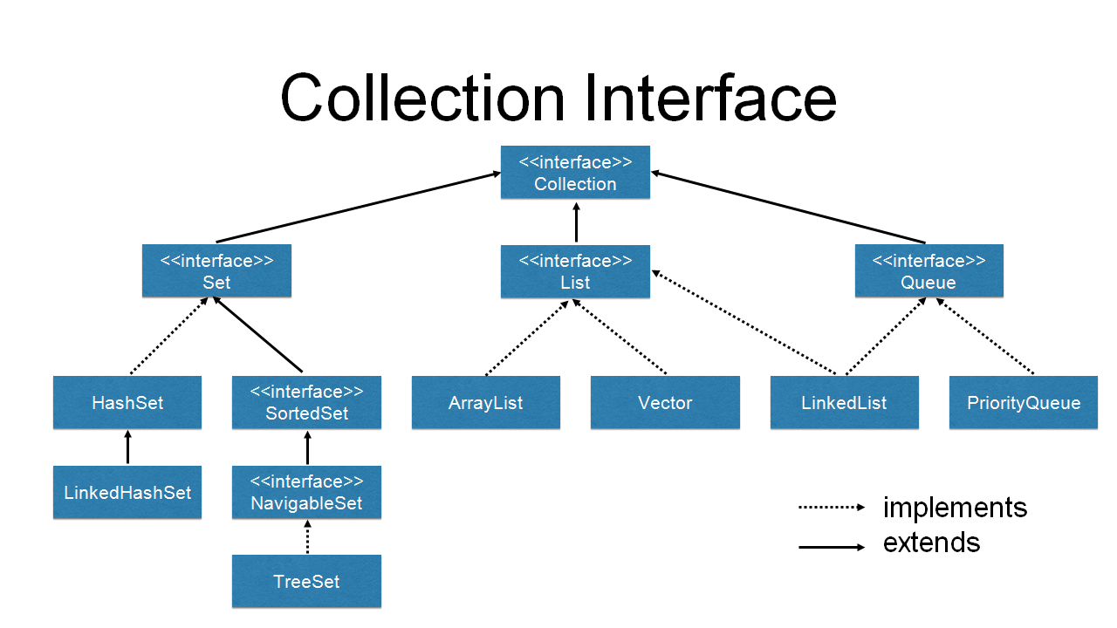

Slide 153
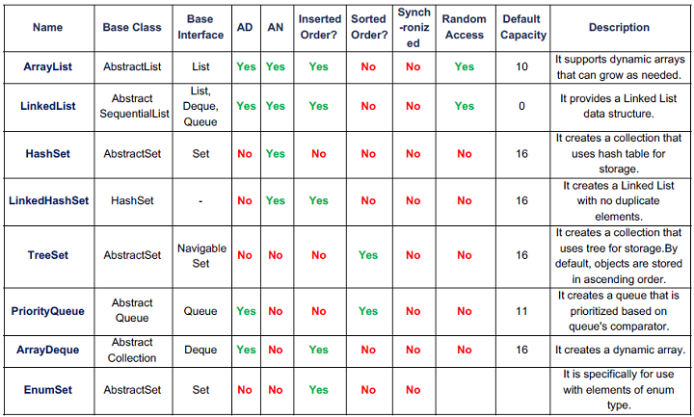
Comparison table

Slide 154
Array Collections
1. Fixed in size. 1.collection is growable in nature,size of the
collection can be decreased at the runtime.
2.It supports only homogenous data 2.By default it supports heterogenous data.
3.No built-in method supports. 3.collections has built-in methods to perform basic and advance operations on the group of data.
4.Don’t have any underlying data structure. 4 it have any underlying data structure.
( that means it will supports static array ) ( that means it will supports static array )
Note: Static arrays have their size or length determined when the array is created and/or allocated. ...
Dynamic arrays has a variable size it allow elements to be added and removed at runtime.

Slide 155
Set :
Set do not store duplicates.
Set do not have index.
Set support to store Only one NULL values.
Set do not preserve insertion order.
List :
1.List can store duplicates.
2.List has index.
3.List support multiple null values.
4.List preserve insertion order.
Queue :
Queue store duplicates.
Queue has index.
Queue support to store multiple null values.
Queue preserve insertion order.

Slide 156
Collection provides an architecture(framework) to store and manipulate the group of objects.
Collection are of 3 types.
1. List
2.Set
3.Queue
LIST:
List has some properties:
1.List can store duplicates.
2.List has index.
3.List support multiple null values.
4.List preserve insertion order.

Slide 157
Collections are used to perform the following operations:
Searching
Sorting
Manipulation
Insertion
Deletion

Slide 158
Arraylist:
Arraylist can store duplicates.
Arraylist has index.
Arraylist support multiple null values.
Arraylist preserve insertion order.
Underlying data structure of arraylist is Resizable array.
Constructor of ArrayList:
Arraylist()
Constructs an empty list with an initial capacity of ten.
Arraylist(Collection c)
Constructs a Arraylist containing the elements of the specified collection.
Arraylist(int initialCapacity)
Constructs an empty list with the specified initial capacity

Slide 159
Arraylist implementation is not synchronized.
Arraylist is NOT THREAD SAFE.
If multiple threads access an Arraylist concurrently, and atleast one of the threads
modifies the list structurally,it will impact on other threads.
VECTOR:
Vector can store duplicates.
Vector has index.
Vector support multiple null values.
Vector preserve insertion order.
Underlying Data structure of vector is Resizable array.
The increase of capacity can be controlled by the programmer by specifying the capacity Increment in the constructor.

Slide 160
Constructors of Vector
Vector()
Constructs an empty vector so that its internal data array has size 10 and its standard capacity increment is zero.
Vector(collection c)
constructs a vector containing the elements of the specified collection.
Vector(int initialcapacity)
constructs an empty vector with the specified initial capacity and with its capacity increment equal to zero.
Vector(int initialCapacity , int capacity increment)
constructs an empty vector with the specified initial capacity and capacity increment.
Vector implementation is synchronized.
Vector is THREAD SAFE.
If multiple threads access an vector concurrently,and at least one of the threads modifies the vector structurally, it will NOT impact on other threads.

Slide 161
Set type of collection
Set do not store duplicates.
Set do not have index.
Set support to store Only one NULL values.
Set do not preserve insertion order.
Hashset:
Hashset do not store duplicates.
Hashset do not have index.
Hashset support to store only one null values.
Hashset do not preserve insertion order.
Underlying datastructure of Hashset is Hash Table.

Slide 162
Constructors of Hashset
Hashset()
constructs a new empty set with initial capacity (16) and load factor (0.75).
Hashset(collection c)
constructs a new set containing the elements in the specified collection.
Hashset(int initial capacity)
constructs a new empty set with specifie initial capacity and default load factor(0.75).
Hashset(int initialcapacity,float loadfactor)
constructs a new empty set with the specified initial capacity and the specified load factor.
Hashset implementation is not synchronized.
Hashset is NOT THREAD SAFE.
If multiple threads access an hashset concurrently and at least one of the threads modifiesthe list structurally,it will impact on other threads.

Slide 163
Linked Hashset:
Linked hashset do not store duplicates.
Linked hashset do not have index.
Linked hashset support to store only one null values.
Linked hashset always preserve insertion order.
Underlying data structures of linked hashset is hash table and linked list.
Constructor of LinkedHashset
LinkedHashset()
constructs a new empty set with initial capacity(16) and load factor(0.75).
LinkedHashset(collection c)
constructs a new,empty set containing the elements in the specified collection .
LinkedHashset(int initialcapacity)
constructs a new empty set with specified initial capacity and default load factor(0.75).
LinkedHashset(int initialcapacity ,float loadfactor)
constructs a new empty set with the specified initial capacity and the specified load factor.

Slide 164
LinkedHashset implementation is not synchronized.
LinkedHashset is NOT THREAD SAFE.
If multiple threads access an linkedhashset concurrently,and atleast one of the threads modifies the list structurally,it will impact on other threads.

Slide 165
Three Cursors in Java Collections
1). Enumeration.
2). Iterator.
3). List Iterator.
The Enum : is a data type which contains a fixed set of constants(unchangeable variables, like final variables).
Iterator : is a cursor which is used to retrive the element present in any given collection.
List Iterator : is used to traverse all types of lists including ArrayList, Vector, LinkedList, Stack etc.

Slide 166
Iterator:
Iterator is a cursor which is used to retrive the element present in any given collection.
Iterator is created automatically whenever the collection object is created.
For every collection a separate iterator is created.
We can access the iterator of the given collection by calling iterator() .
The iterator reference returned by the iterator() should be stored with in a reference variable of iterator type.

Slide 167
Lambda function:
It is an Anonymous(nameless) function which is used to provide implementation for abstract method present in functional interface.
An Interface which contains only one Abstract method is called as functional interface.
Functional interface:
We have 4 functional interface
1.consumer
2.predicate
3.function
4.supplier

Slide 168
Syntax:
InterfaceName ref-var = (argument list) ->
{
statements;
statements;
return;
};
-> : it is used to link argument list and body of expression

Slide 169
TreeSet:
It is a non-linear data structure where data is stored according to some relation.
Tree consists of nodes and links.
Node consists of data and address of other data.
The link represents the relation between one node to another node.
Treeset do not store duplicates.
Treeset do not have index.
Treeset do not support to store null values(not even one null value) if you try to add
null value then jvm will throws nullpointer exception.
Treeset do not preserve insertion order.
Treeset do not allow heterogenous data.

Slide 170
Tree Set constructor
Default natural sorting .
Treeset t=new Treeset();
Creats an empty Treeset objects where elements will be inserted according to default natural sorting order.
2. Camparator c.
Treeset t=new Treeset(comparator c);
Creats an empty Treeset Object where elements will be insertesd according to customized sorting order.
3.Collection object.
Treeset t =new Treeset(collection c);
4.SortedSet s
Treeset t =new Treeset(sortedset s);

Slide 171
Queue:
Queue store duplicates.
Queue has index.
Queue support to store multiple null values.
Queue preserve insertion order.
Priority queue:
Priority queue store duplicates.
Priority queue do not have index.
It is not support to store null values(not even one null) if you try to add null value then JVM throws null pointer exception.
Priority queue do not preserve insertion order.
Priority queue do not allow heterogenous data.
Underlying data structure of priority queue is priority heap.

Slide 172
Data from priority queue is retrived using poll().
poll() :Retrive and remove the head element of the queue.
Constructors of priority queue:
Priorityqueue( ):
creates a priority queue with the default initial capacity that order its elements according to there natural ordering.
Priority queue(comparator c):
creates a priority queue with the default initial capacity and where elements are ordered according to the specified comparator.
Priority queue(int initial capacity):
creates a priority queue with the specified initial capacity that orders its elements according to there natural ordering.
Priority queue(int initial capacity,comparator c):
creates a priority queue with the specified initial capacity that orders its elements according there specified comparator.

Slide 173
LINKEDLIST:
It stores duplicates.
It has index.
It support to store multiple null values.
It do preserve insertion order.
Underlying data structure of linked list is doubly linked list.
Data from linkedlist is retrived using poll( ) or get(index).
Constructor of linked list:
Linked list( ):
Constructs an empty list.
Linkedlist(collection c ):
Constructs a list containing the elements of the specified collection.

Slide 174
Map
a) Hash Map:
Duplicate keys are not allowed in Map.
It doesn’t maintain any insertion order and is unsorted.
Example:
Public class Fruit{
Public static void main(String[ ] args){
HashMap&lt;Sting,String&gt; names =new HashMap&lt;String,String&gt;( );
names.put(“key1”,“cherry”);
names.put (“key2”,“banana”);
names.put (“key3”,“apple”);
names.put (“key4”,“kiwi”);
names.put (“key1”,“cherry”);
System.out.println(names);
}
}
Output:
{key2 =banana, key1=cherry, key4 =kiwi, key3= apple}

Slide 175
b) Hash Table:
Like the vector key, methods of the class are synchronized.
Thread safety and therefore slows the performance.
It doesn’t allow anything that is null.
Example:
public class Fruit{
public static void main(String[ ]args){
Hashtable&lt;Sting,String&gt; names =new Hashtable&lt;String,String&gt;( );
names.put(“key1”,“cherry”);
names.put(“key2”,“apple”);
names.put(“key3”,“banana”);
names.put(“key4”,“kiwi”);
names.put(“key2”,“orange”);
System.out.println(names);
}
}
Output:
{key2=apple, key1=cherry,key4=kiwi, key3=banana}

Slide 176
c) Linked Hash Map:
Maintains insertion order.
Slower than Hash map.
Example:
public class Fruit{
public static void main(String[ ] args){
LinkedHashMap&lt;Sting,String&gt; names =new LinkedHashMap&lt;String,String&gt;( );
names.put(“key1”,“cherry”);
names.put(“key2”,“apple”);
names.put(“key3”,“banana”);
names.put(“key4”,“kiwi”);
names.put(“key2”,“orange”);
System.out.println(names);
}
}
Output:
{key2=apple, key1=cherry,key4=kiwi, key3=banana}

Slide 177
d) TreeMap:
Sorted Map.
Like Tree set, we can construct a sort order with the constructor.
Example:
public class Fruit{
public static void main(String[ ]args){
TreeMap&lt;Sting,String&gt; names =new TreeMap&lt;String,String&gt;( );
names.put(“key1”,“cherry”);
names.put(“key2”,“banana”);
names.put(“key3”,“apple”);
names.put(“key4”,“kiwi”);
names.put(“key2”,“orange”);
System.out.println(names);
}
}
Output:
{key1=cherry, key2=banana, key3 =apple, key4=kiwi}
It is sorted in ascending order based on the key. Duplicate keys are not allowed.

Slide 178
Enum
The Enum in Java is a data type which contains a fixed set of constants(unchangeable variables, like final variables).
The Java enum constants are bydefault static and final.
The main objective of enum Enums are used to create our own data type like classes.
It is available since JDK 1.5.

Slide 179
Class | Interface
It is created using a keyword “class” | It is created using a keyword “interface”
objects of a class can be created. | An Interface cannot be instantiated i.e, objects cannot be created.
Classes does not support multiple inheritance. | Interface supports multiple inheritance.
It can be inherit another class. | It cannot inherit a class.
It can be inherited by another class using the keyword ‘extends’. | It can be inherited by a class by using the keyword ‘implements’ and it can be inherited by an interface using the keyword ‘extends’.
It can contain constructors. | It cannot contain constructors.
It cannot contain abstract methods. | It contains abstract methods only.
Variables and methods in a class can be declared using any access specifier(public, private, default, protected) | All variables and methods in a interface are declared as public.
Variables in a class can be static, final or neither. | All variables are static and final.

Slide 180
Ordered: here the values that are stored in a collection is based on the values that are added to the collection.
Sorted: it is done internally or externally so here the values that are stored in a collection is based on the properties of an object.
final keyword in Java
Final variable: Once a variable is declared as final, then the value of the variable could not be changed. It is like a constant.
Example:
final int = 12;
Final method: if we declared a method as final that method cannot be overridden. Or cannot be inherited.
Final class: If a class is declared as final, the main purpose of class being declared as final is because to prevent the classs from being subclassed.

Slide 181
Transient variable: It is a special type of variable which have a non-serialized value at the time of serialization.
Volatile variable: is used to modify the value of a variable by different threads.
Java is not fully object oriented because it supports primitive data type like it,byte,long etc, which are not objects
Data encapsulation, also known as data hiding, is the mechanism whereby the implementation details of a class are kept hidden from the user. Class is the best example of Data Encapsulation. It sometimes referred to as data hiding that prevents the user to access the implementation details.

